Slide 1
17기 정규세션
ToBig’s 16기 강의자
김건우
Ensemble

Slide 2
Unit 01 ㅣ Introduction
Unit 02 ㅣ Voting
Contents
Unit 03 ㅣ Bagging
Unit 04 ㅣ Boosting
Unit 05 ㅣ Stacking

Slide 3
Unit 01 ㅣIntroduction
Unit 01 - Introduction

Slide 4
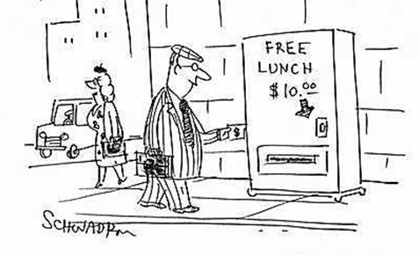
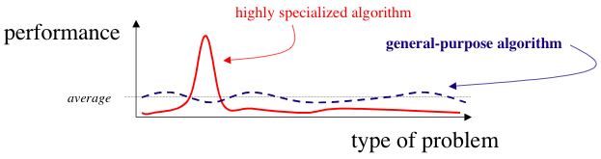
Unit 01 ㅣIntroduction
No Free Lunch Theorem (NFLT)
“We have dubbed the associated results “No Free Lunch” theorems because they demonstrate that if an algorithm performs well on a certain class of problems then it necessarily pays for that with degraded performance on the set of all remaining problems.” - 「No Free Lunch Theorems for Optimization(1997)」 (William Macready)

Slide 5

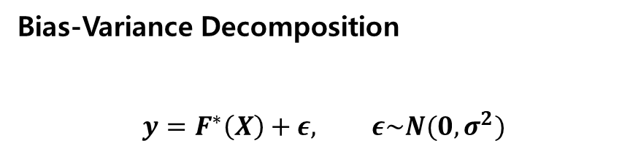



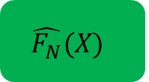

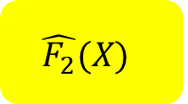

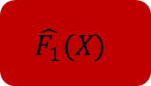
Unit 01 ㅣIntroduction
Bias-Variance Decomposition
$$y=F^{∗}\left(X\right)+ε, ε\sim N(0,σ^{2})$$
Dataset 1
$$F^{∗}\left(X\right)+ε$$
$$\hat{F_{1}}(X)$$
$$X$$
$$F^{∗}$$
Dataset 2
$$F^{∗}\left(X\right)+ε$$
$$\hat{F_{2}}(X)$$
...
...
Dataset N
$$F^{∗}\left(X\right)+ε$$
$$\hat{F_{N}}(X)$$
$$\overline{F}\left(X\right)=E(\hat{F_{D}}(X))$$

Slide 6
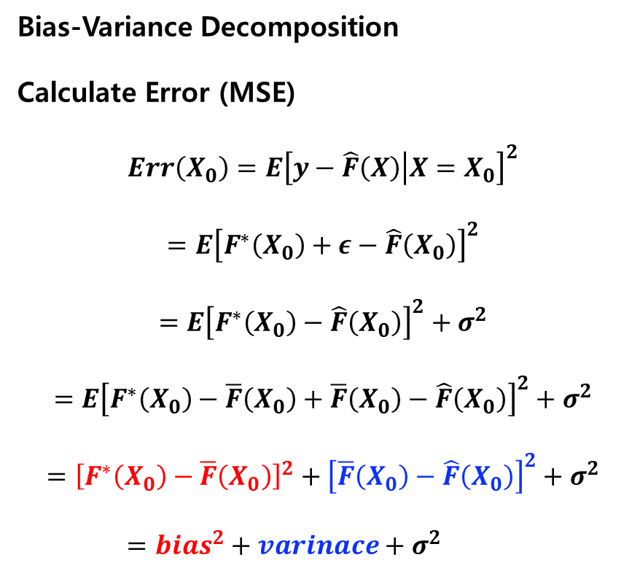
Unit 01 ㅣIntroduction
Bias-Variance Decomposition
Calculate Error (MSE)
$$Err\left(X_{0}\right)=E{\left[y−\hat{F}\left(X\right) | X=X_{0}\right]}^{2}$$
$$=E{\left[F^{∗}\left(X_{0}\right)+ε−\hat{F}\left(X_{0}\right)\right]}^{2}$$
$$=E{\left[F^{∗}\left(X_{0}\right)−\hat{F}\left(X_{0}\right)\right]}^{2}+σ^{2}$$
$$=E{\left[F^{∗}\left(X_{0}\right)−\overline{F}\left(X_{0}\right)+\overline{F}\left(X_{0}\right)−\hat{F}\left(X_{0}\right)\right]}^{2}+σ^{2}$$
$$={\left[F^{∗}\left(X_{0}\right)−\overline{F}\left(X_{0}\right)\right]}^{2}+{\left[\overline{F}\left(X_{0}\right)−\hat{F}\left(X_{0}\right)\right]}^{2}+σ^{2}$$
$=bias^{2}+varinace+σ^{2}$

Slide 7
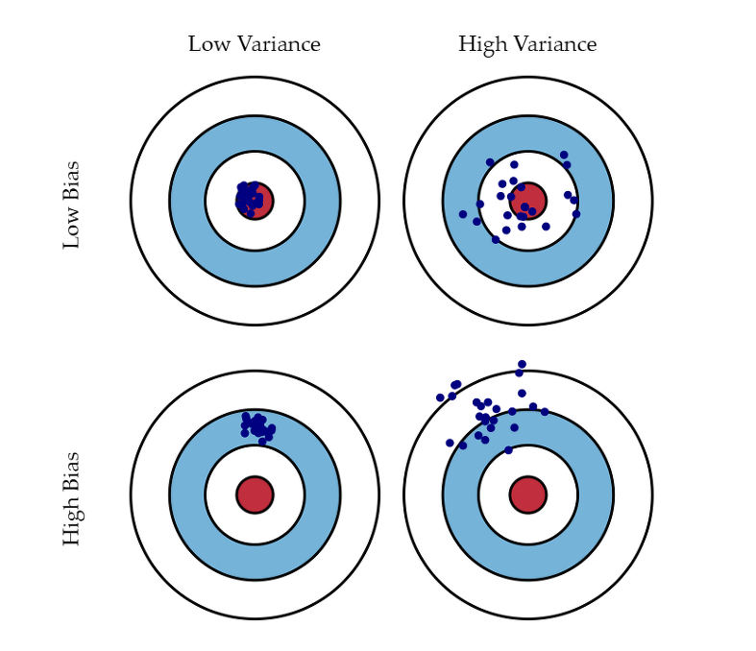
Unit 01 ㅣIntroduction
Bias-Variance Decomposition
Bias: difference between predicted value and expected value
Low Bias: Accurately estimate the function
High Bias: Imply a poor match
Variance: when the model takes into account the fluctuations in the data
Low Variance: Estimated function doesn’t change much
High Bias: Imply a weak match
High Bias + Low Variance: Logistic Regression, LDA, KNN
Low Bias + High Variance: ANN, SVM, DT
Low Bias + Low Variance: Best Model!!!

Slide 8
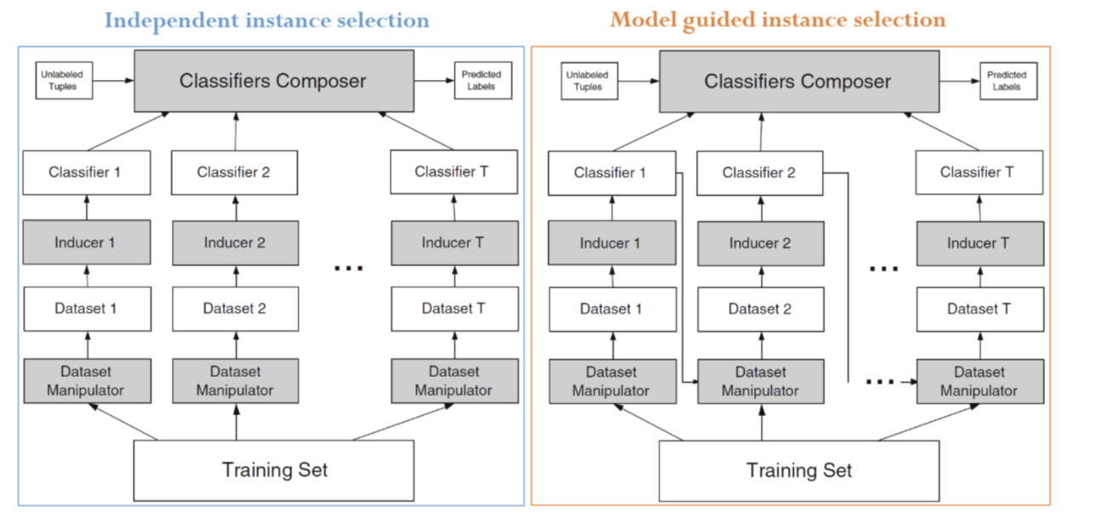
Unit 01 ㅣIntroduction
Why do we learn Ensemble?
In order to reduce bias, we should use Ensemble model based on ‘Boosting’ strategy
In order to reduce variance, we should use Ensemble model based on ‘Bagging’ strategy

Slide 9
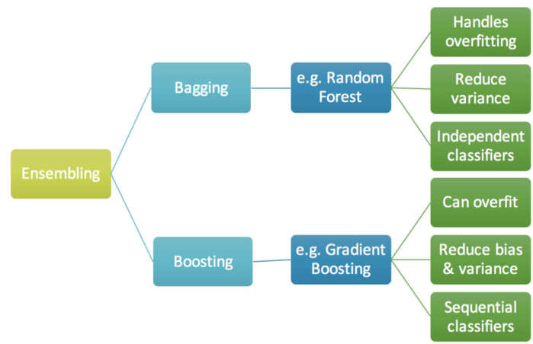
Unit 01 ㅣIntroduction
Why do we learn Ensemble?

Slide 10
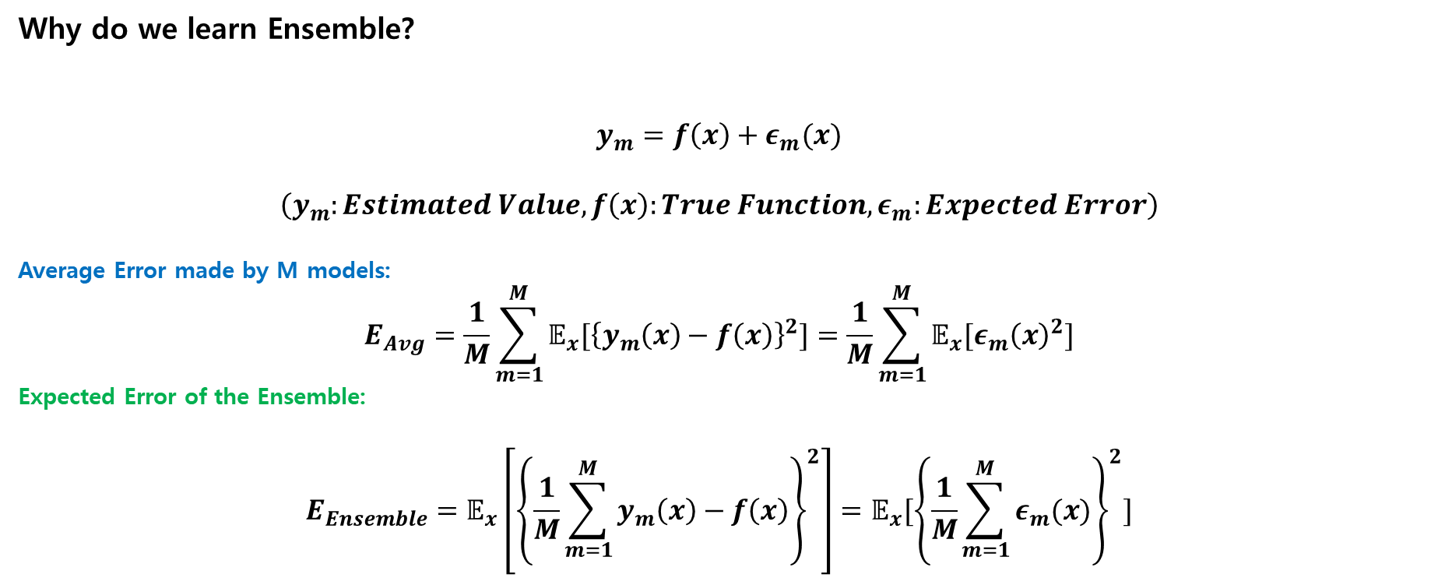
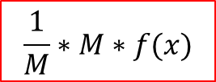
Unit 01 ㅣIntroduction
Why do we learn Ensemble?
$$y_{m}=f\left(x\right)+ε_{m}(x)$$
$$\left(y_{m}:Estimated Value, f\left(x\right):True Function,ε_{m}:Expected Error\right)$$
Average Error made by M models:
$$E_{Avg}=\frac{1}{M}\sum_{m=1}^{M}{𝔼_{x}[{\left\{y_{m}\left(x\right)−f\left(x\right)\right\}}^{2}]}=\frac{1}{M}\sum_{m=1}^{M}{𝔼_{x}[ε_{m}{\left(x\right)}^{2}]}$$
Expected Error of the Ensemble:
$$E_{Ensemble}=𝔼_{x}\left[{\left\{\frac{1}{M}\sum_{m=1}^{M}{y_{m}\left(x\right)}−f\left(x\right)\right\}}^{2}\right]=𝔼_{x}[{\left\{\frac{1}{M}\sum_{m=1}^{M}{ε_{m}(x)}\right\}}^{2}]$$
$$\frac{1}{M}∗M∗f(x)$$

Slide 11
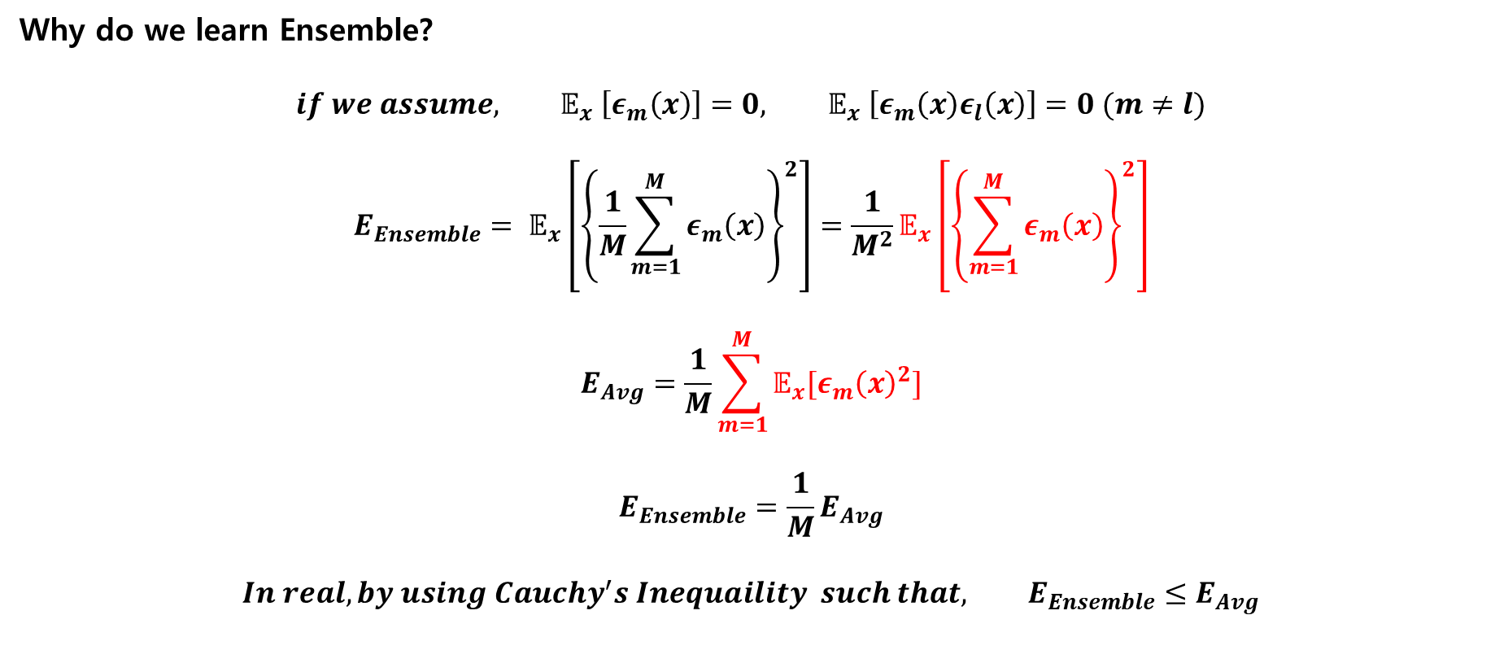
Unit 01 ㅣIntroduction
Why do we learn Ensemble?
$$if we assume, 𝔼_{x} \left[ε_{m}\left(x\right)\right]=0, 𝔼_{x} \left[ε_{m}\left(x\right)ε_{l}\left(x\right)\right]=0 (m≠l)$$
$$E_{Ensemble}= 𝔼_{x}\left[{\left\{\frac{1}{M}\sum_{m=1}^{M}{ε_{m}\left(x\right)}\right\}}^{2}\right]=\frac{1}{M^{2}}𝔼_{x}\left[{\left\{\sum_{m=1}^{M}{ε_{m}\left(x\right)}\right\}}^{2}\right]$$
$$E_{Avg}=\frac{1}{M}\sum_{m=1}^{M}{𝔼_{x}[ε_{m}{\left(x\right)}^{2}]}$$
$${E_{Ensemble}=\frac{1}{M}E}_{Avg}$$
$$In real, by using Cauchy^{′}s Inequaility such that, E_{Ensemble}≤E_{Avg}$$

Slide 12
Unit 02 ㅣVoting
Unit 02 - Voting

Slide 13

Unit 02 ㅣVoting
Voting
Hard voting: out of multiple outputs produced by the classifiers, the majority output is chosen to be the final result of the model
Soft voting: Sums the predicted probabilities for class labels and returns the final classification with the largest sum probability.

Slide 14
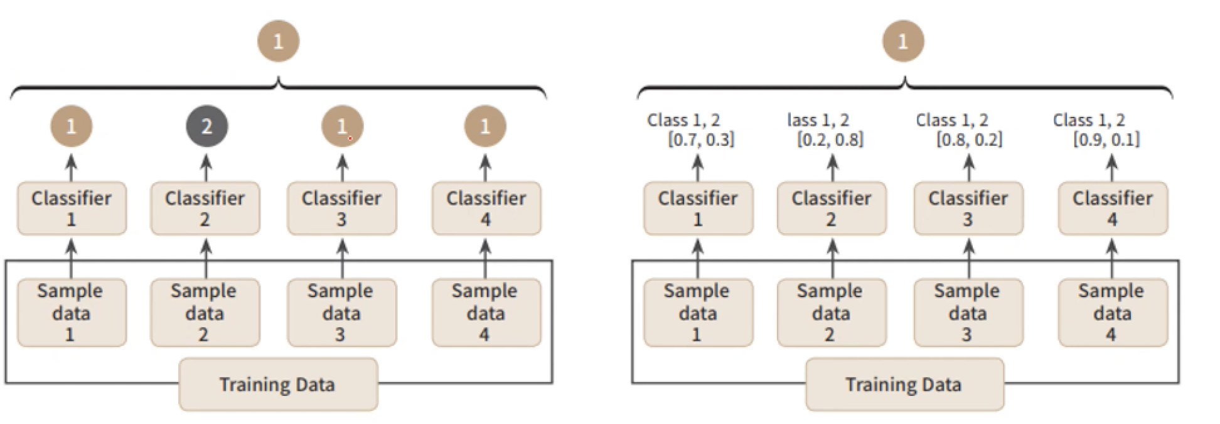
Unit 02 ㅣVoting
Voting
Hard voting
Soft voting
$p\left(class=1 | X\right)=\frac{0.7+0.2+0.8+0.9}{4}=0.65$, $p\left(class=2 | X\right)=\frac{0.3+0.8+0.2+0.1}{4}=0.35$

Slide 15
Unit 03 ㅣBagging
Unit 03 - Bagging

Slide 16
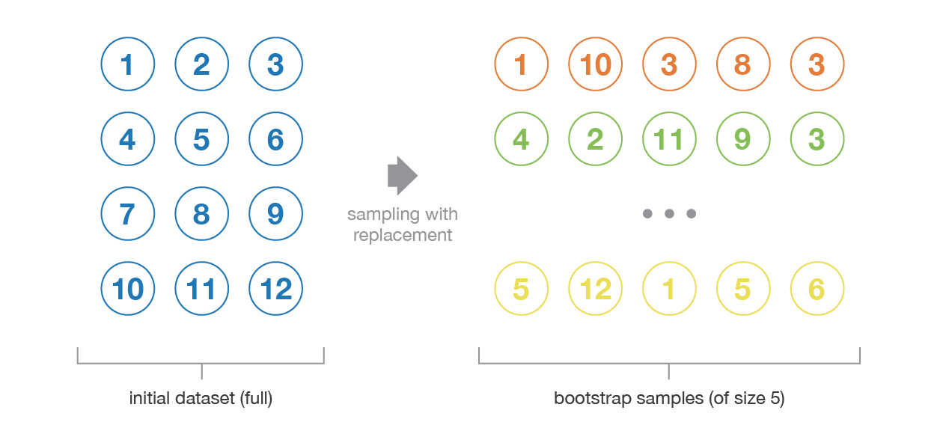

Unit 03 ㅣBagging
Bagging (Bootstrap Aggregating)
The objective is to create several subsets of data from training sample chosen randomly with replacement in order to reduce the variance.
$$y=f\left(x\right)+ε$$

Slide 17
Unit 03 ㅣBagging
Bagging (Bootstrap Aggregating)
$$p={\left(1−\frac{1}{N}\right)}^{N}⟶\lim_{N⟶∞}{{\left(1−\frac{1}{N}\right)}^{N}}⟶e^{−1}=0.368=36.8\%$$
Out Of Bag data (OOB)
$$1−p=1−0.368=73.2\%$$
Sampled more than once in bootstrap

Slide 18
Unit 03 ㅣBagging
Bagging (Bootstrap Aggregating)
Train Data (70%)
Val Dat (30%)
Bootstrap-1
Bootstrap-2
Bootstrap-3
Train-1
Train-2
Train-3
Model
OOB-1
OOB-2
OOB-3
Model-1
Model-2
Model-3

Slide 19
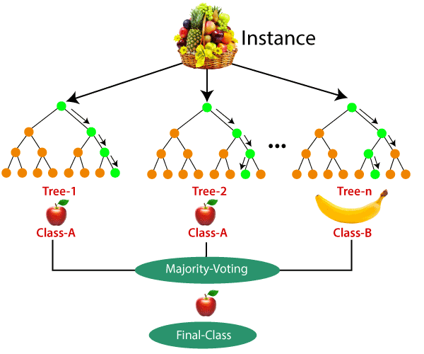
Unit 03 ㅣBagging
Random Forest
A specialized bagging for DT (base learner)
Based on Bagging Ensemble
Randomly choose variables
Random Forest Algorithm Procedures
Select random ‘K’ data points from the training set
Build the Decision Trees associated with the selected data points (subsets)
Choose the number of ‘N’ for Decision Trees that you want to build
Repeat Step1 and Step2
For new data points, find the predictions of each decision tree, and assign the new data points to the category that wins the majority votes
Randomly select ‘m’ variables

Slide 20
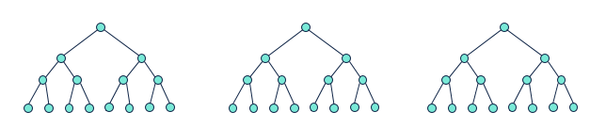
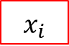
Unit 03 ㅣBagging
Random Forest
Able to use on both classification and regression tasks
Handle ‘Missing Values’ well
Each tree (base learner) in random forest may overfit the data because ‘pruning‘ is not conducted
Prevents overfitting problem
Variable Importance --→ Not suggest which variables to select
Difficult to interpret the results (Black-Box Model)
Too slow when the number of data size is large
$$x_{i}$$

Slide 21
Unit 04 ㅣBoosting
Unit 04 - Boosting

Slide 22
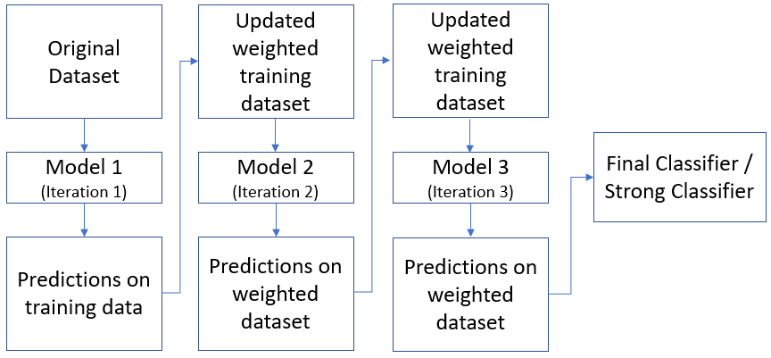
Unit 04 ㅣBoosting
Boosting: An iterative procedure to adaptively change distribution of training data by focusing more on previously mis-classified records.
Sequential learning process unlike ‘Bagging’ (parallel learning)
Weak learner

Slide 23
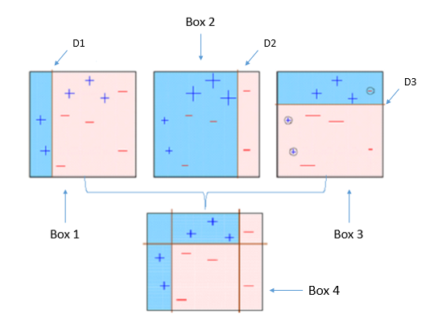
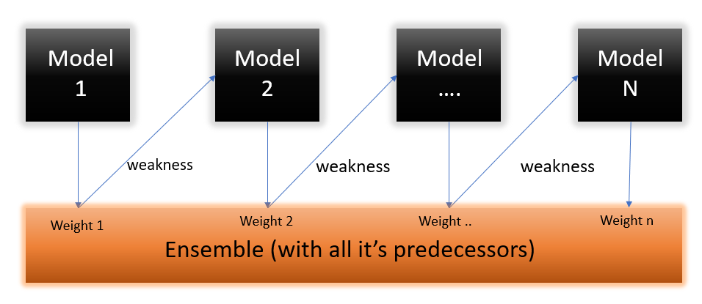
Unit 04 ㅣBoosting
AdaBoost (Adaptive Boosting)
Weak learner, performing only slightly better than random guessing, could be boosted in to arbitrarily accurate strong learner

Slide 24
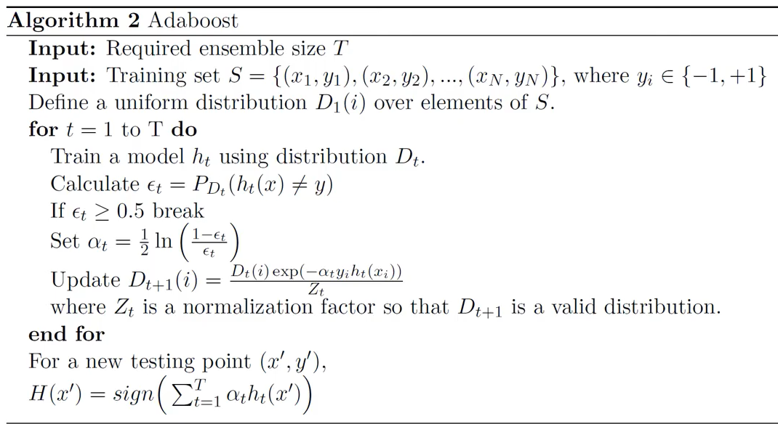
Unit 04 ㅣBoosting
AdaBoost (Adaptive Boosting)

Slide 25
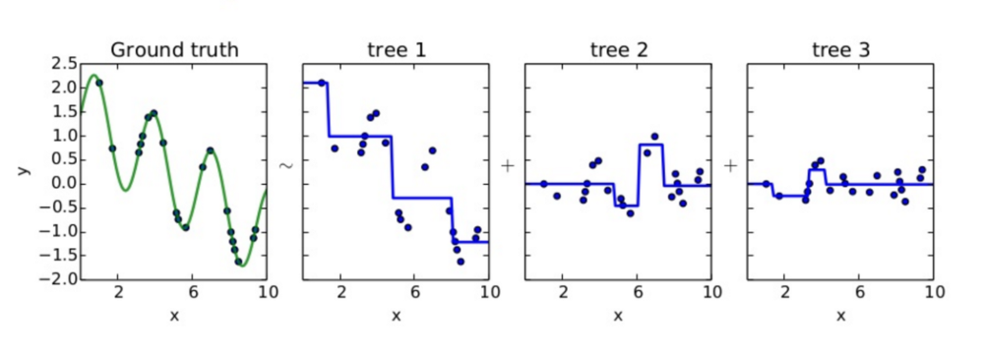
Unit 04 ㅣBoosting
GBM (Gradient Boosting Machine)
AdaBoost: update weights on Dataset by sampling
GBM: update ‘y’ not Dataset
Understand the concept of ‘Residual Fitting’

Slide 26
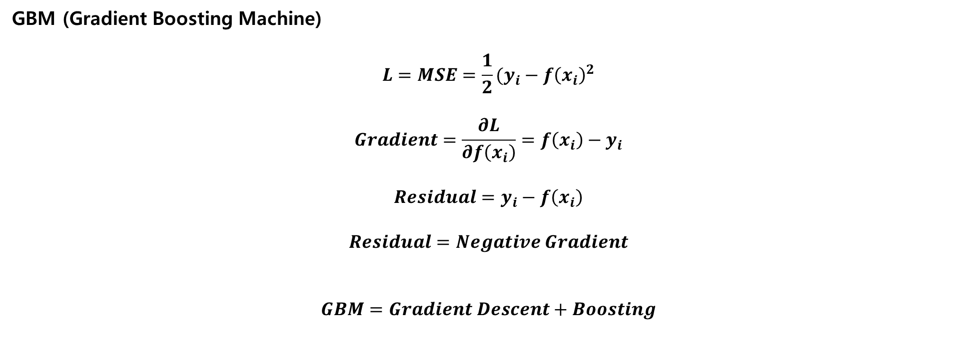
Unit 04 ㅣBoosting
GBM (Gradient Boosting Machine)
$$L=MSE=\frac{1}{2}(y_{i}−f{\left(x_{i}\right)}^{2}$$
$$Gradient=\frac{∂L}{∂f\left(x_{i}\right)}=f\left(x_{i}\right)−y_{i}$$
$$Residual=y_{i}−f\left(x_{i}\right)$$
$$Residual=Negative Gradient$$
$$GBM=Gradient Descent+Boosting$$

Slide 27
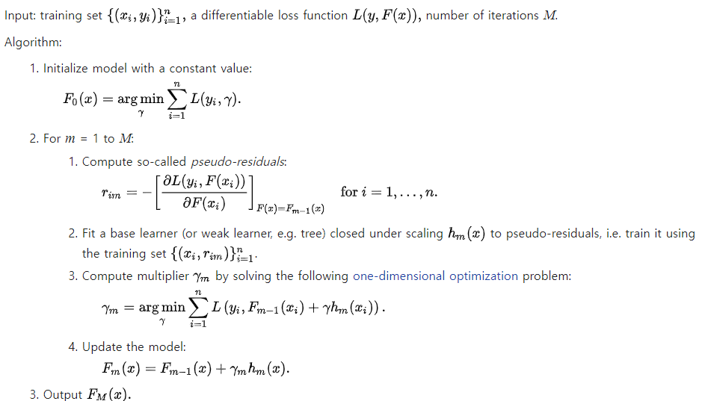
Unit 04 ㅣBoosting
GBM (Gradient Boosting Machine)

Slide 28
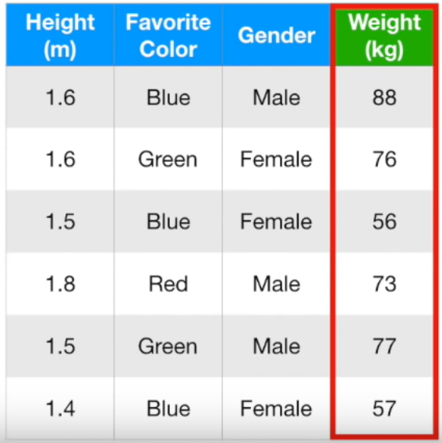
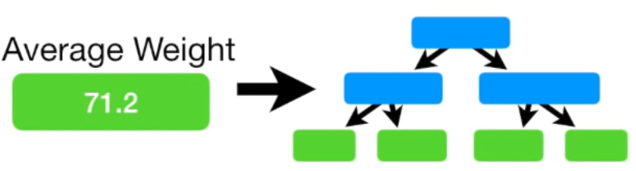
Unit 04 ㅣBoosting
GBM (Gradient Boosting Machine)

Slide 29
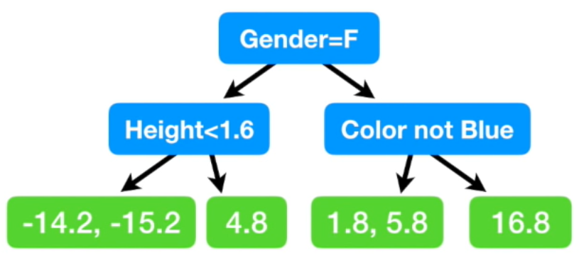
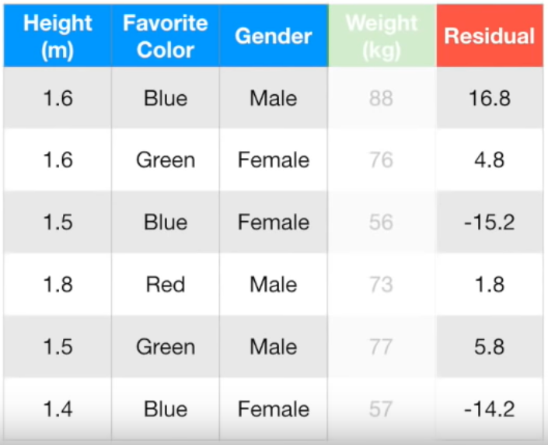
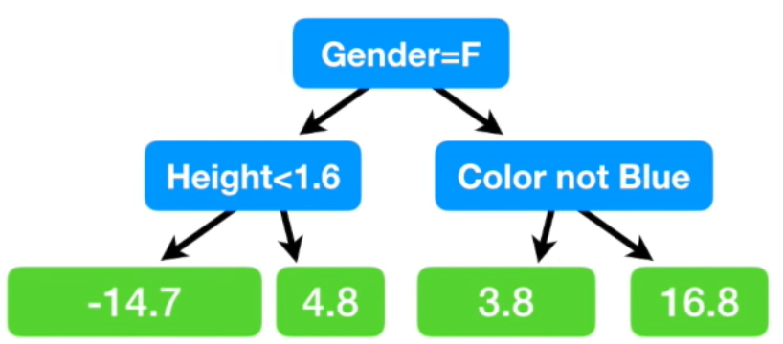
Unit 04 ㅣBoosting
GBM (Gradient Boosting Machine)
Average leaf

Slide 30
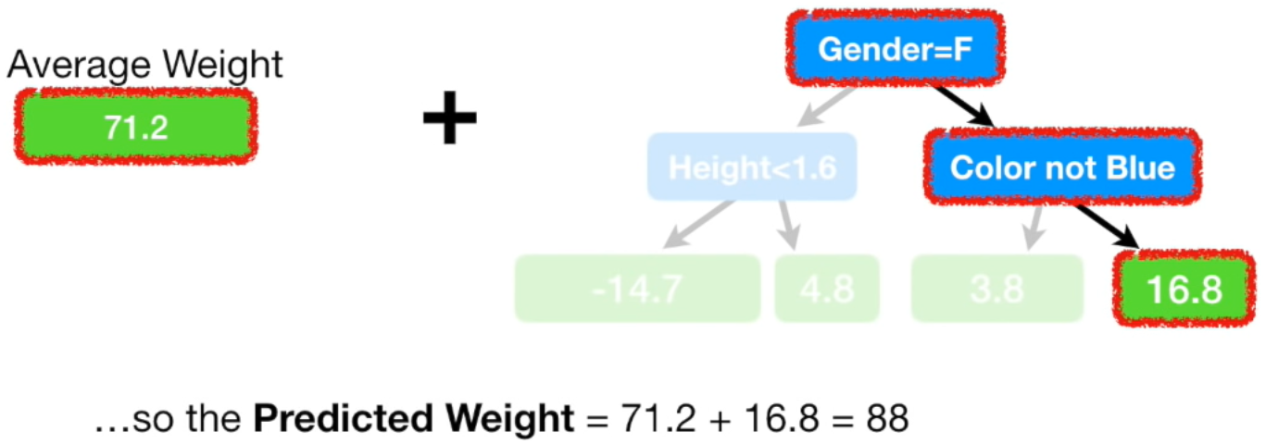
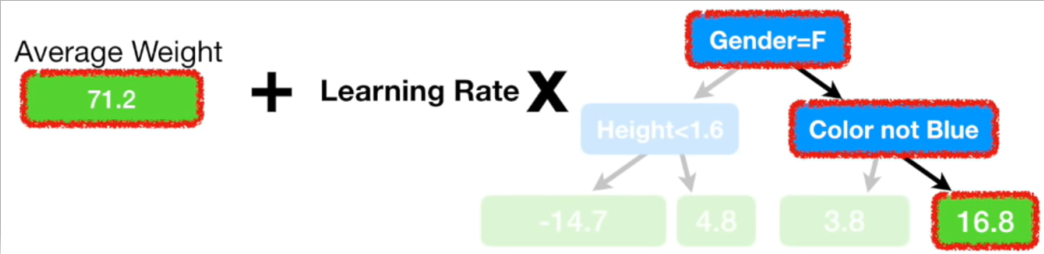
Unit 04 ㅣBoosting
GBM (Gradient Boosting Machine)
Learning Rate = 0.1

Slide 31
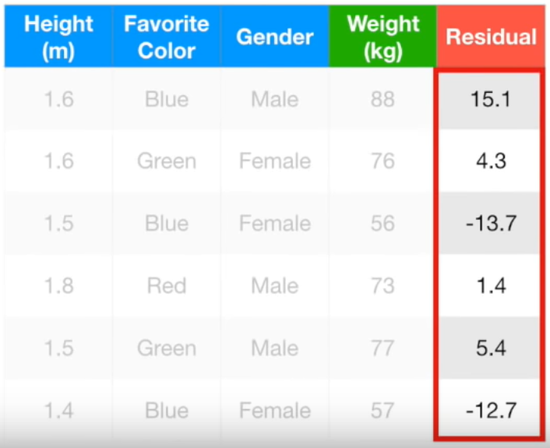
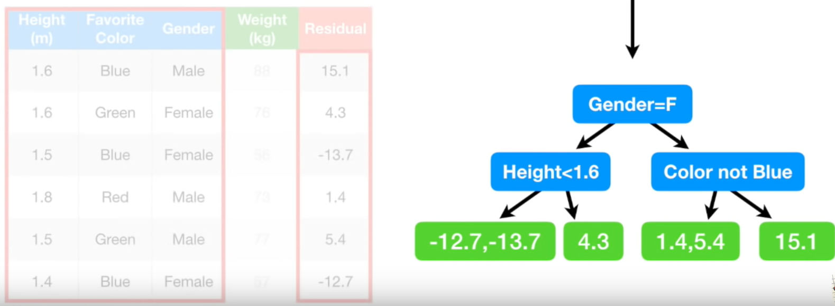
Unit 04 ㅣBoosting
GBM (Gradient Boosting Machine)

Slide 32
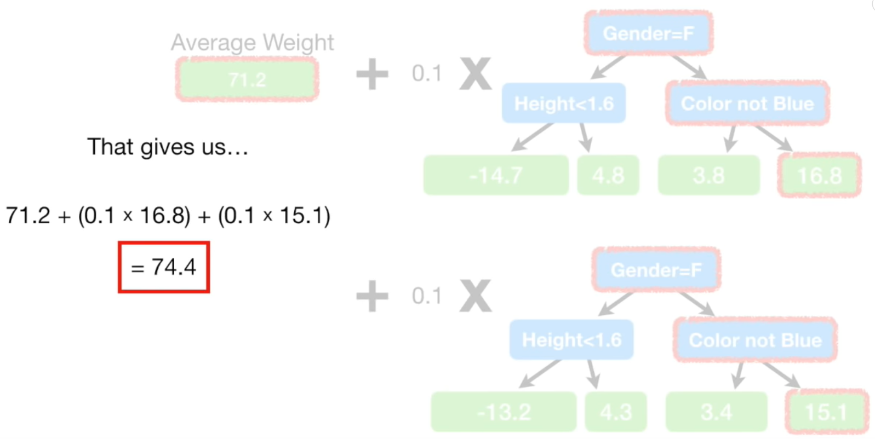
Unit 04 ㅣBoosting
GBM (Gradient Boosting Machine)

Slide 33
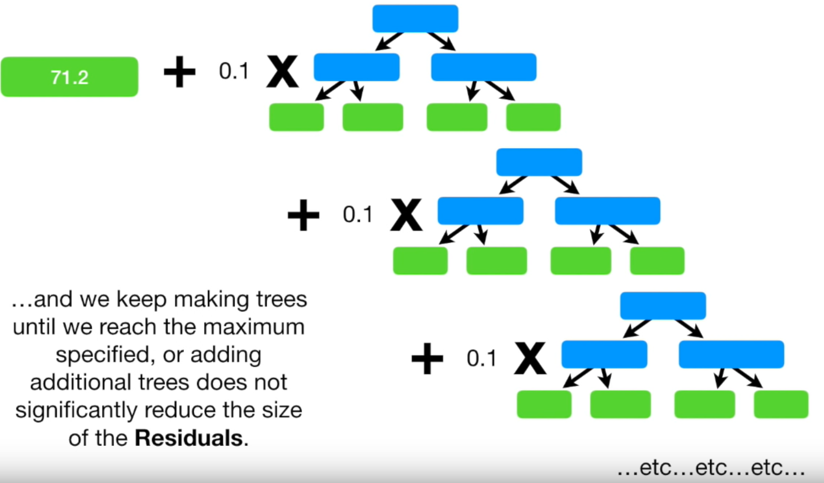
Unit 04 ㅣBoosting
GBM (Gradient Boosting Machine)
…
…

Slide 34





Unit 04 ㅣBoosting
Boosting
…
…

Slide 35
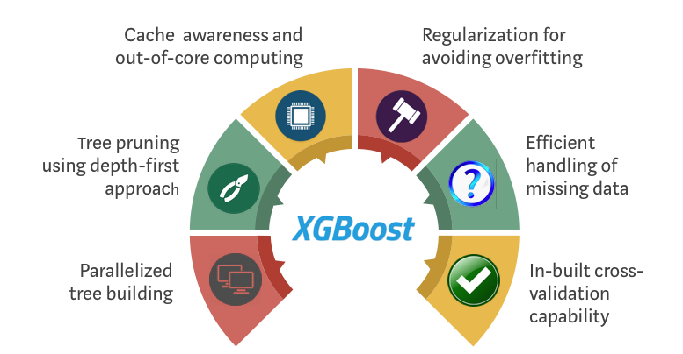
Unit 04 ㅣBoosting
XGBoost (eXtreme Gradient Boosting)
→ An optimized distributed gradient boosting model designed to be highly efficient, flexible and portable.
Optimization
Parallelziation
Tree Pruning
Algorithm
Regularization
Built-in Cross Validation
Sparsity Awareness
Hardware Optimization

Slide 36
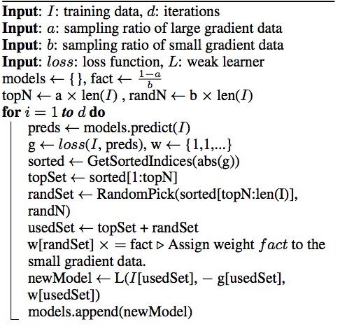
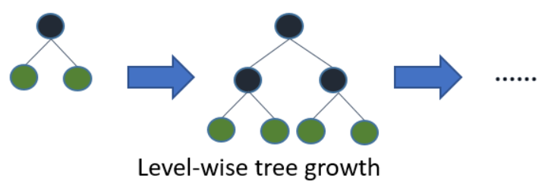
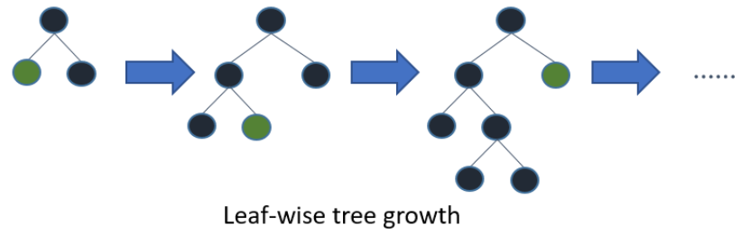
Unit 04 ㅣBoosting
Light GBM (Light Gradient Boosting Machine)
Gradient-based One-Side Sampling (GOSS)

Slide 37
Unit 04 ㅣBoosting
Boosting
GBM
XGB
(2014)
LGBM
(2016)
CATB
(2017)
Parallel processing
Pruning types
Regularization
Sparsity awareness
Built-in CV
Complex hyperparameters
Leaf wise tree growth
GOSS
Overfitting
(low # of data)
Handle categorical variables well
Slower than LGBM (training)
Low performance
(most variables are numeric, not categoric)

Slide 38
Unit 05 ㅣStacking
Unit 05 - Stacking

Slide 39
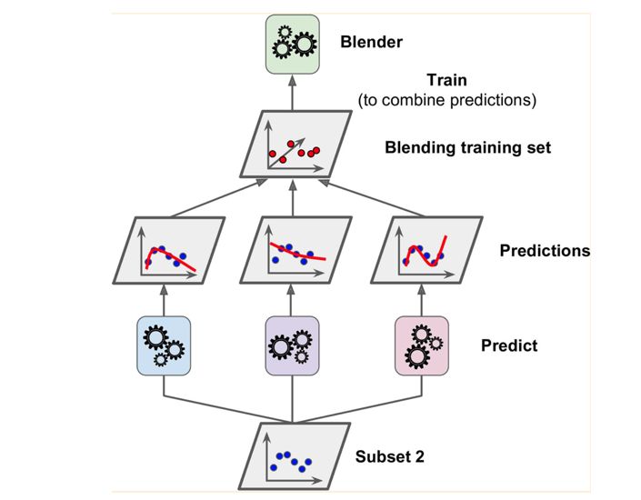
Unit 05 ㅣStacking
Stacking
Use Meta-Learner to aggregate the results
Meta-Learner’s Input: predicted values from base-learners
Meta-Learner’s Output: actual true labels

Slide 40
Unit 05 ㅣStacking
Stacking Example
# of data: 569
# of features: 30
Train data shape: (455,30) - 80% of data
Test data shape: (114,30) – 20% of data
Weak Learners: XGBoost(XGB), Light GBM(LGBM), SVM, ANN (Use models with high complexity)
Concatenate prediction values from weak learners: XGB_pred, LGBM_pred, SVM_pred, ANN_pred -> shape (114,4)
Meta Learner: Logistic Regression (Use a model with low complexity)
Meta Learner fitting: Use concatenated values (114,4) as X, use (114,) as Y
Final output: (114,)

Slide 41
Unit 05 ㅣStacking
Stacking
Pros: Improve performance
Cons: Overfitting
How to solve Overfitting problem?
Stacking based on Cross Validation

Slide 42
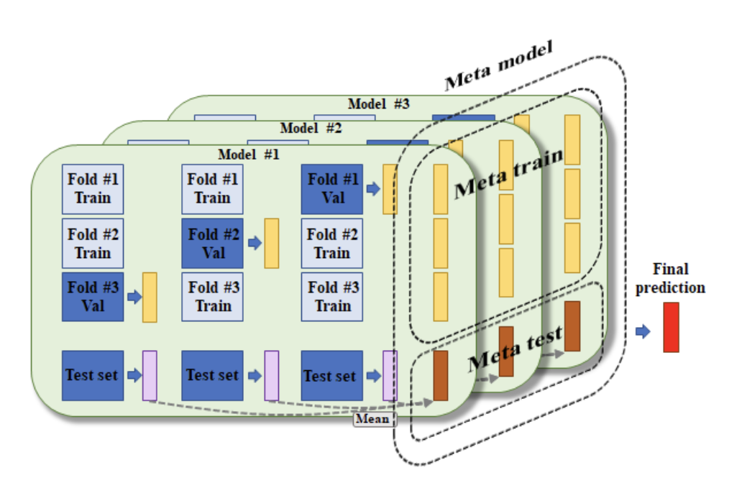
Unit 05 ㅣStacking
Stacking based on Cross Validation

Slide 43
Unit 05 ㅣStacking
Stacking based on Cross Validation
New X_train
Original y_train
Evaluate performance between Original y_test and Estimated y_test from stacking
Fit on New X_test
Train on meta-learner

Slide 44
Conclusion
Ensemble = “Diversity”
Voting (Hard Voting vs Soft Voting)
Bagging (Random Forest)
Boosting (AdaBoost, GBM, XGB, LightGBM, CatBoost)
Stacking (Stacking based on CV)

Slide 45
Conclusion
Assignment
Kaggle Competition에 참여하여 가장 좋은 Model 을 만들어 보세요!
채점 기준은 다음과 같습니다.
Leaderboard score
EDA
모델의 결과에 대한 설명
2주차에 배운 Hyperparameter Tuning과 1~5주차에 배운 다양한 모델과 기법들을 활용해보세요!
Baseline Model의 performance를 모두 넘어야 합니다!!!
(Kaggle Link)
https://www.kaggle.com/t/933534784e1b4c71abc4918ad97d5271

Slide 46
Reference
https://velog.io/@jiselectric/Ensemble-Learning-Voting-and-Bagging-at6219ae
https://www.shutterstock.com/ko/image-vector/voting-ballot-box-icon-election-vote-1342666166
https://blog.naver.com/PostView.nhn?blogId=ckdgus1433&logNo=221588139765
https://huidea.tistory.com/35
https://lsjsj92.tistory.com/559
https://www.javatpoint.com/machine-learning-random-forest-algorithm
https://community.alteryx.com/t5/image/serverpage/image-id/33046iB8743F7094DB9C87/image-size/large?v=1.0&px=999
https://michael-fuchs-python.netlify.app/2020/03/26/ensemble-modeling-boosting/
https://injo.tistory.com/31
https://www.analyticsvidhya.com/blog/2021/09/adaboost-algorithm-a-complete-guide-for-beginners/
https://3months.tistory.com/368
https://koalaverse.github.io/machine-learning-in-R/gradient-boosting-machines.html
https://www.youtube.com/channel/UCPq01cgCcEwhXl7BvcwIQyg
https://www.youtube.com/watch?v=3CC4N4z3GJc
https://bkshin.tistory.com/entry/%EB%A8%B8%EC%8B%A0%EB%9F%AC%EB%8B%9D-15-Gradient-Boost
https://statinknu.tistory.com/33
https://wyatt37.tistory.com/5

Slide 47
Q & A
들어주셔서 감사합니다.

